Slide 1

BRAIN TUMOR DETECTION
By
Swapan Kumar Shee
(B.Tech 3rd Year CSE, Enrollment No.:12021002001009 )
Shivam Kumar Mishra
(B.Tech 3rd Year AIML, Enrollment No.:12021002001042 )
Under the Supervision of
Prof. Jyoti Khandelwal
Dept. of Computer Science & Engineering
University of Engineering & Management, Jaipur

Slide 2
Outlines
Introduction
Literature Review
Objectives
Proposed Model
Experimental Setup
Result Analysis
Conclusion & Future Scope
Reference
Acknowledgement

Slide 3
Introduction
Brain MRI Images is helpful in brain tumor diagnosis process. Tumor and cancer is a harmful and death-defying disease for human life.
In this study importance of the image classification in the world of the Biocomputing field explored.
Image classification technique is efficiently improving the process of disease diagnosis. It is a process in which images are labeled into numerous predefined classes.
Several techniques has been introduced for image classification like Logistic Regression, Random Forest, SVM,KNN and many others.
In this study we proposed a model in which deep neural network technique is used with grey scaled segmentation technique. Combination of these two techniques is giving better result in minimum computational time.

Slide 4
Literature Review
Serial No. | Authors | Topic | Conclusion
1. | Hemanth G, Janardhan M, Sujihelen L (2019) [1] | Design and implementing brain tumor detection using machine learning approach. | By utilizing the DM (data mining) techniques, significant relations and patterns from the data can be extracted.
2. | Somasundaram S, Gobinath R (2019) [2] | Current trends on deep learning models for brain tumor segmentation and detection—a review. | 3D NN( Neural Network ) and Computational Machine learning that assists in processing the input images at multiple scales simultaneously.

Slide 5
Literature Review Cont...
Serial No. | Author | Topic | Conclusion
3. | Çınarer G, Emiroğlu BG (2019) [3] | Classification of brain tumors by machine learning algorithms. | SVM (support vector machines) algorithm with 90% accuracy rate was found to be better compared to other algorithms.
4. | Wu W et al (2020) [4] | Intelligent diagnosis method of brain MRI tumor segmen-tation using deep convoluti-onal neural network and SVM algorithm. | The performance of the proposed model is significantly better than the deep convolutional neural network and the integrated SVM classifier.

Slide 6
Objectives
To accurately identify the presence and type of a tumor in the brain. This information is essential for developing an effective treatment plan.
To Early detection of brain tumors is crucial, as malignant tumors can quickly grow and spread. By detecting tumors early, doctors can intervene with treatment before they cause significant damage to the brain.
To detect brain tumors, including MRI scans, CT scans, and PET scans. These imaging techniques can provide detailed images of the brain, which can be used to identify tumors and other abnormalities.
To Save patient’s time and get timely consultation.

Slide 7
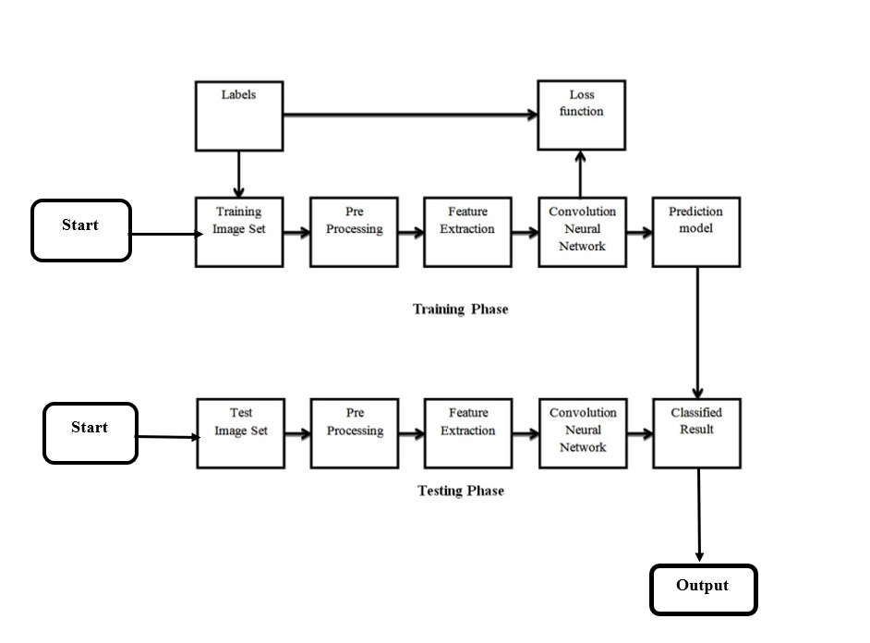
Proposed Model
Fig .1 Proposed model

Slide 8
Experimental Set-up
Software Requirements | Hardware Requirements
Operating system: Windows(10) or Linux or MAC | Processor: intel core i5
Programming language: python | Hard disk:10 GB minimum
Editor and compiler(IDE): Juypter Notebook(6.5.3) | RAM:256 MB or more

Slide 9
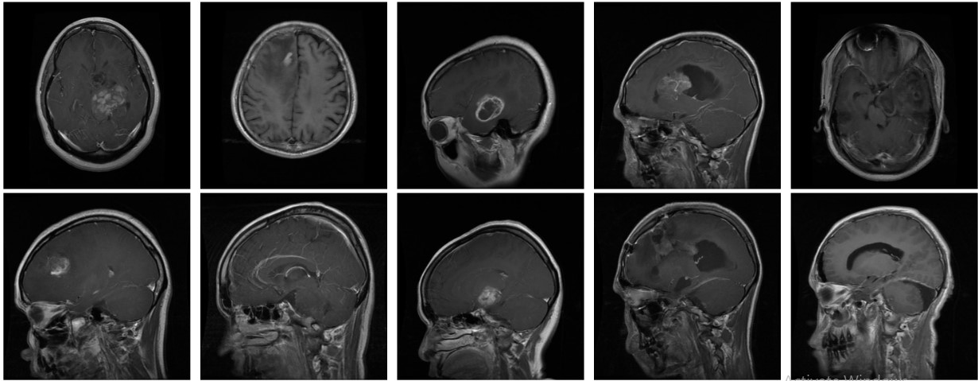
Result
Fig.2 Some sample MRI Images from Training Dataset

Slide 10
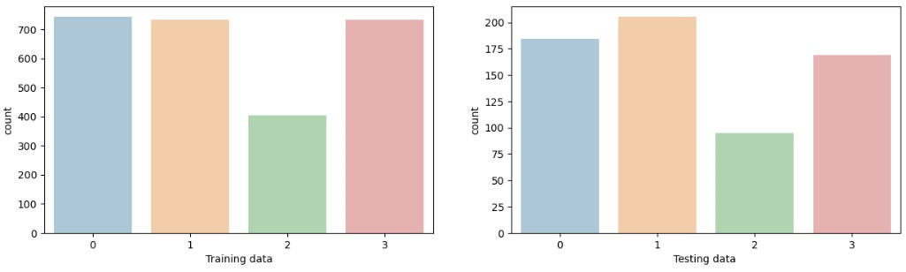
Result Cont.…..
(a) (b)
Fig.3 Data set partitions (a) Train Data; (b) Test Data

Slide 11
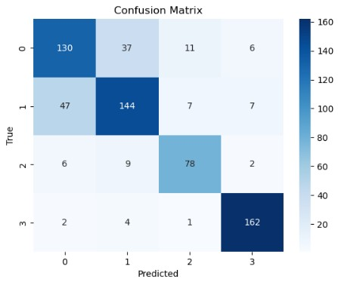
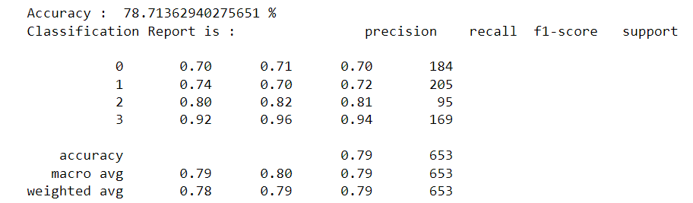
Result Cont.….
(a)
(b)
Fig. 4 Logistic Regression results (a) Confusion matrix; (b) Classification report.

Slide 12
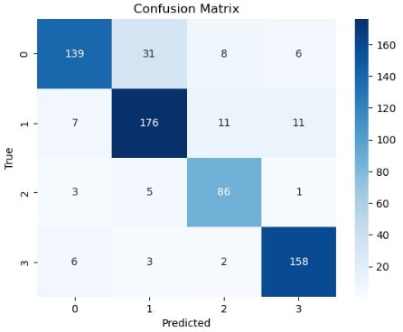
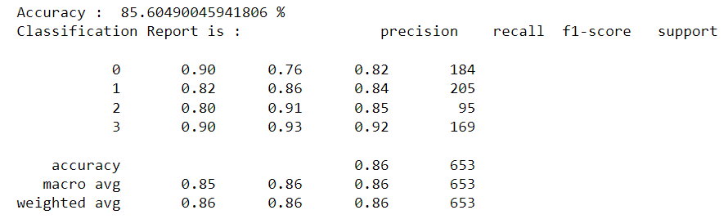
Result Cont.….
(a)
(b)
Fig. 5 Random Forest results (a) Confusion martrix; (b) Classification report.

Slide 13
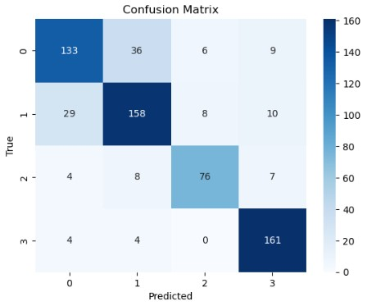
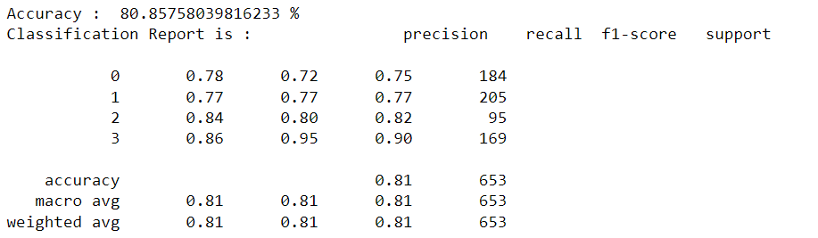
Result Cont.….
(a)
(b)
Fig. 6 Support vector machine results (a) Confusion martrix; (b) Classification report.

Slide 14
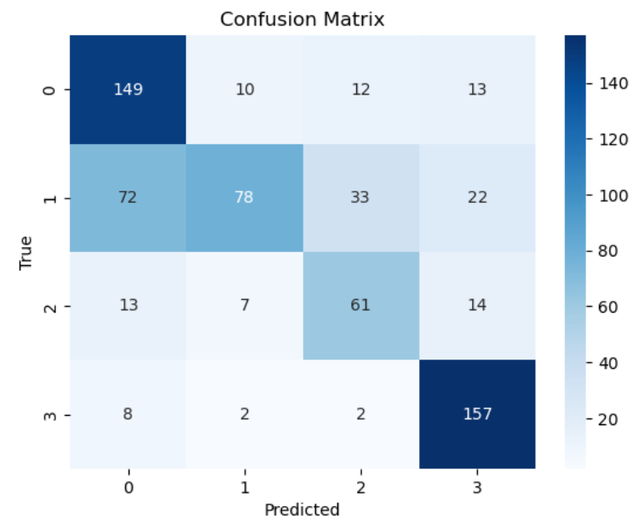
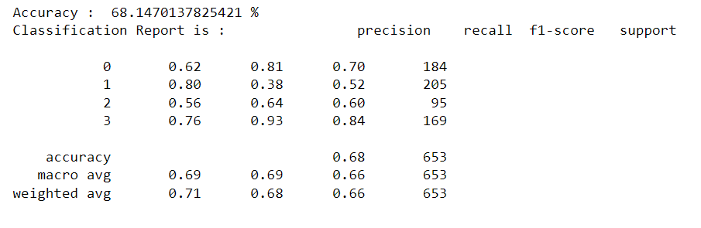
Result Cont.….
(a)
(b)
Fig. 7 KNN Classifier results (a) Confusion martrix; (b) Classification report.

Slide 15
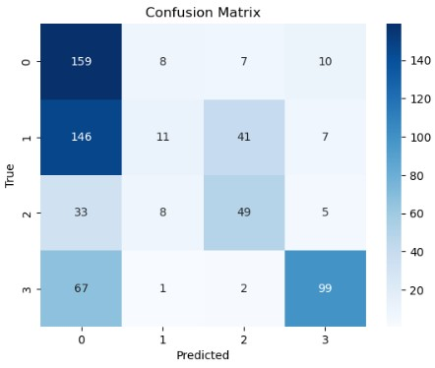
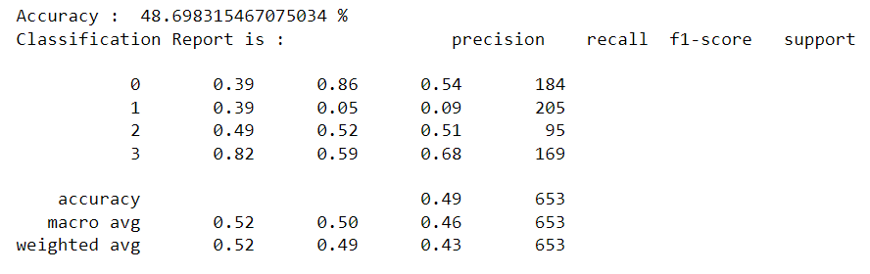
Result Cont.….
(a)
(b)
Fig. 8 Naive bayes results (a) Confusion martrix; (b) Classification report.

Slide 16
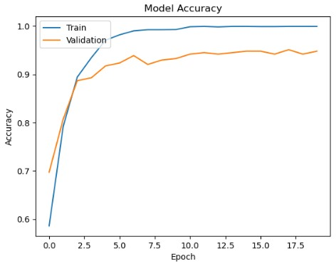
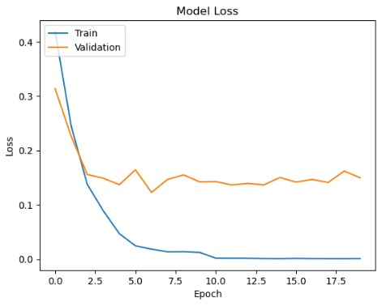
Result Cont.….
(a)
(b)
Fig.10 Training and Validation Model results (a) Accuracy of CNN; (b) Loss of CNN

Slide 17
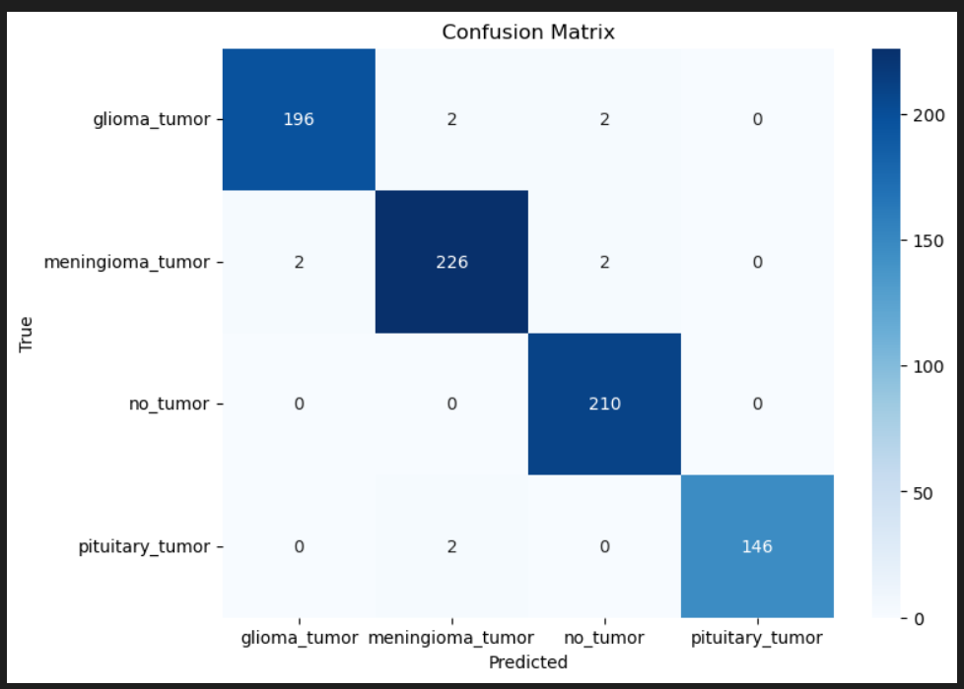
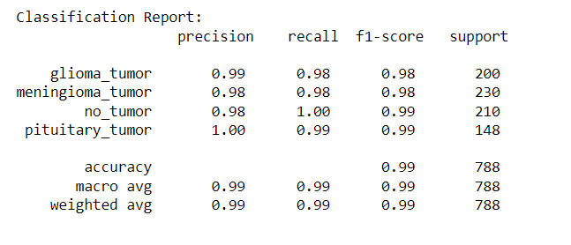
Result Cont.….
(a)
(b)
Fig.9 CNN Results (a) Confusion Matrix; (b) Classification Report

Slide 18
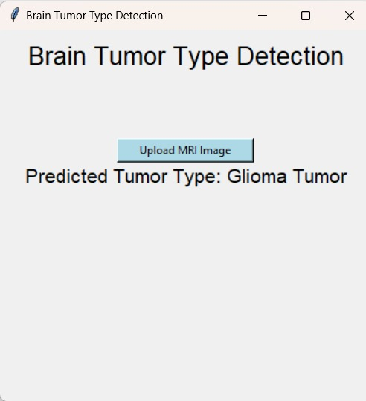
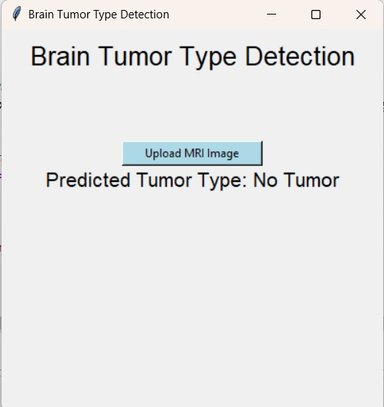
Result Cont.…
(a)
(b)
Fig.11 (a)Test1; (b)Test2
Dept. of CSE, University of Engineering &
Management Jaipur

Slide 19
Result Analysis
This proposed brain tumor detection model achieved an accuracy of 98.73%, on a Test Dataset of 394. This indicates that the model is able to accurately detect brain tumors. The high sensitivity of the model suggests that it is able to correctly identify most brain tumors, while the high specificity suggests that it is able to correctly identify most non-tumorous cases.
Kaggle data set: - https://www.kaggle.com/datasets/sartajbhuvaji/brain-tumor-classification-mri
The results of this study suggest that the proposed brain tumor detection model is a promising tool for the diagnosis of brain tumors. The model is able to accurately detect brain tumors in most cases, and it is also able to perform well on challenging cases.
The GUI provided a user-friendly interface for individuals to interact with the model, making predictions on new MRI images without the need to run the entire script.

Slide 20
Conclusions & Future Scope
Our project achieved success in implementing a robust CNN for brain tumor classification in MRI scans, demonstrating promising performance.
Acknowledging limitations like dataset size and interpretability issues, the project sets the stage for future enhancements in this critical medical field.
Build an app-based user interface in hospitals which allows doctors to easily determine the impact of tumor and suggest treatment accordingly.
Collaborating with healthcare institutions for extensive clinical validation will validate the model's efficacy in real-world scenarios, ensuring its practical utility and compliance with medical standards.

Slide 21
References
Hemanth G, Janardhan M, Sujihelen L (2019) Design and implementing brain tumor detection using machine learning approach. In: 3rd international conference on trends in electronics and informatics (ICOEI). https://doi.org/10.1109/ICOEI.2019.8862553
Somasundaram S, Gobinath R (2019) Current trends on deep learning models for brain tumor segmentation and detection—a review. In: International conference on machine learning, big data, cloud and parallel computing (COMITCon). https://doi.org/10.1109/COMITCon.2019.8862209
Çınarer G, Emiroğlu BG (2019) Classification of brain tumors by machine learning algorithms. In: 3rd international symposium on multidisciplinary studies and innovative technologies (ISMSIT). https://doi.org/10.1109/ISMSIT.2019.8932878
Wu, W., Li, D., Du, J., Gao, X., Gu, W., Zhao, F., Feng, X., &amp; Yan, H. (2020, July 14). An intelligent diagnosis method of brain MRI tumor segmentation using deep convolutional neural network and SVM algorithm. Computational and Mathematical Methods in Medicine. https://www.hindawi.com/journals/cmmm/2020/6789306/

Slide 22
Acknowledgement
The endless thanks goes to Lord Almighty for all the blessings he has showered onto me, which has enabled me to write this last note in my project work. During the period of my project, as in the rest of my life, I have been blessed by Almighty with some extraordinary people who have spun a web of support around me. Words can never be enough in expressing how grateful I am to those incredible people in my life who made this thesis possible. I would like an attempt to thank them for making my time during my project in the Institute a period I will treasure. I am deeply indebted to my research supervisor, Professor Jyoti Khandelwal me such an interesting thesis topic. Each meeting with him added in valuable aspects to the implementation and broadened my perspective. He has guided me with his invaluable suggestions, lightened up the way in my darkest times and encouraged me a lot in the academic life.

Slide 23

Dept. of CSE, University of Engineering & Management Jaipur

